Slide 1
Battery Backup/ Uninterruptible Power Systems
Reliable Power-----Is important to effectively maintain signal controls and communications for life and safety. Increased usage has reduced our overall power resources reliability.
Effective Power-----Is important today because our US power generation companies have not built any new power generation facilities in over 15 years. Therefore we must utilize our existing capacity to its foremost effectiveness.
Expensive Power----Is something we are all living with and with governmental decisions allowing increased profitability rather than reliability, we must increase our own protection and reliability.
Most standard traffic signal cabinets utilize 120VAC power which is routed through one or two circuit breakers to supply cabinet equipment.

Slide 2
Battery Backup/ Uninterruptible Power Systems
MAINTAIN FULL COLOR - During power outages - planned or unplanned.
STOPS “ALL” POWER PROBLEMS- Brownouts, spikes, sags, surges. Clean, regulated, power to all signals, controllers, cameras and sensitive electronics.
ELIMINATE- Nuisance calls to reset offline controllers Relieves POLICE from directing traffic during blackouts and maintenance.
The system is designed to power the entire intersection (all phases) for approximately 2‐7 hours of run time
Time can be increased with Flash function installed

Slide 3
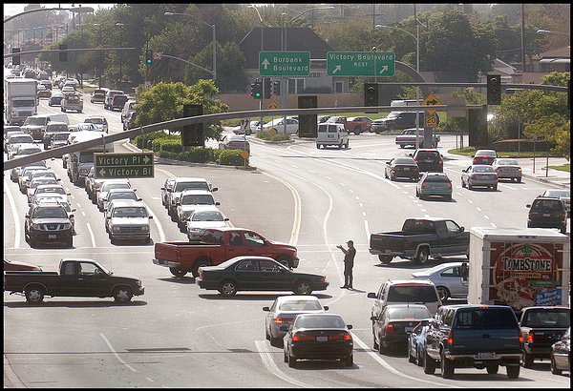
Battery Backup/ Uninterruptible Power Systems

Slide 4
Types and Voltages
Uninterruptible Power Systems
(Dual Conversion)
Battery Back Up
(Buck and Boost)
Typically 48 VDC to 72 VDC

Slide 5
Manufacturers
Myers PowerBack --BBS-Line Interactive, Buck-Boost options
Dimensions Unlimited—BBS
PowerSystems Inc—Canadian-FERRO BBS Conversion-
Quixote—Line Interactive-BBS-Buck option
TechPower Developments Inc—Canadian-Single Conversion BBS
Signal Sense—BBS-Repackaged Marine Inverter
Econolite—Relabeled TechPower BBS
Alpha Technologies—BBS-Line Interactive, Buck-Boost options
Always ON UPS—Canadian-BBS-Line Interactive, Buck-Boost
TESCO—BBS-Line Interactive—Relabeled APC Office BBS

Slide 6
UNINTRUPTIBLE POWER SYSTEMS
An uninterruptible power supply (UPS) is a device that will provide continuous power even when the utility power fails.
Rectifier takes input utility AC to DC then filters and adjusts input current to near unity.
DC-DC Regulation converter
High Power Inverter output conversion to regulated AC

Slide 7
UNINTRUPTIBLE POWER SYSTEMS

Slide 8
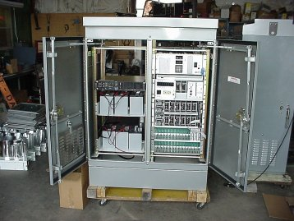
UNINTRUPTIBLE POWER SYSTEMS
Unit
Battery

Slide 9
BATTERY BACK UP Systems
Battery backup system, or BBS, is an addition to the circuitry of a signalized intersection that will allow it to run on battery power in the event of a power outage.
An automatic transfer switch from utility power to battery power typically occurs within milliseconds
Uses Buck and Boost system to regulate power problems

Slide 10
BATTERY BACK UP Systems

Slide 11
Compressed Natural Gas
Unlike a portable generator the CNG generator gets its fuel from the natural gas line provided by the utility company, therefore, an uninterrupted source as long as there is not damage to the natural gas supply
This system currently has a small BBS built in to detect the loss of power and after several minutes on the BBS the power is transferred to the generator

Slide 12
Compressed Natural Gas

Slide 13
Compressed Natural Gas (CNG)

Slide 14
Compressed Natural Gas (CNG)

Slide 15
Questions?

